Slide 1
Machine Learning Operations (MLOps) and Lifecycle
Module 1

Slide 2
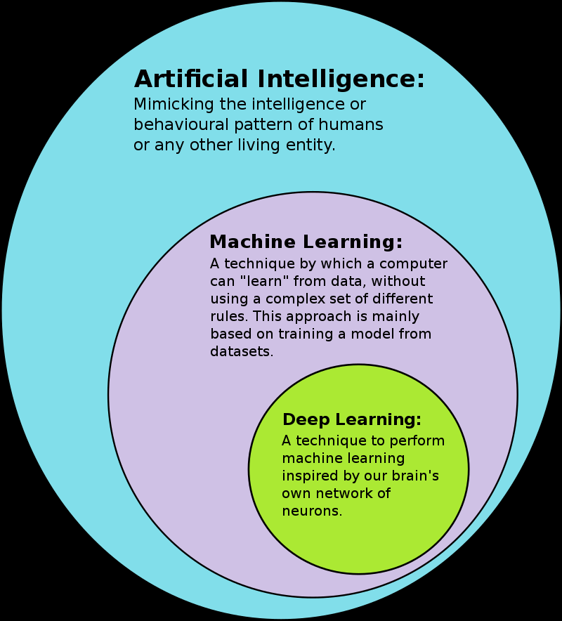
1. Machine Learning Fundamentals and Lifecycle
According to Wikipedia, Data Science is the processes and systems to extract knowledge or insight from data, either structured or unstructured.
Machine learning is a subfield of Artificial Intelligence where machines learn to make high precision predictions by learning from a large amount of data.
Existence of large among of high quality-data is critical for building machine learning models and application
https://commons.wikimedia.org/w/index.php?curid=90131352

Slide 3

Machine learning (ML) is continually maturing and being adopted by more businesses.
Companies are continuously improving services by collecting, storing, and processing a massive amount of data from user interactions.
This trend of massive data generation/collection has been shaping the evolution of IT infrastructure and software development.
Businesses are adopting cloud computing to scale their operations by outsourcing their IT infrastructure and using cloud services for storage, networking, and computation.

Slide 4
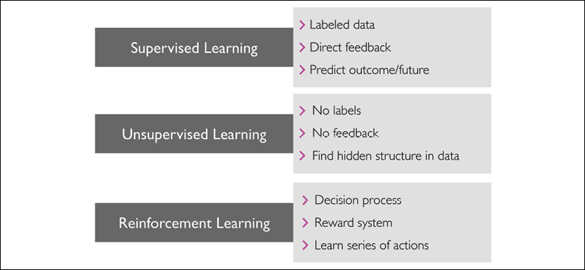
There are three main types of machine learning:
Supervised learning: Training data is labeled
Unsupervised learning: Training data is not labeled
Reinforcement learning: Learning based on rewards

Slide 5
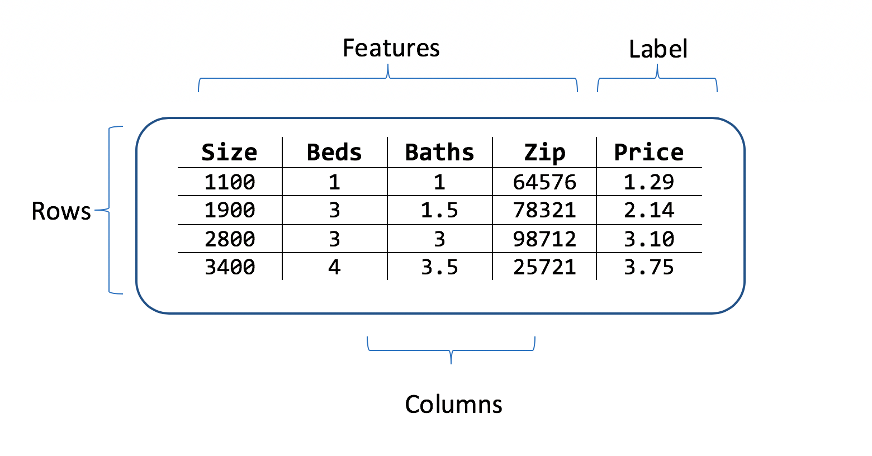
Some key terms in Machine Learning:
Dataset: This is a set or a collection of data. This set is normally presented in a tabular form. Every column describes a particular variable/feature. And each row corresponds to an observation of given variables of the data set.
Feature: Also called the attribute or the independent variable or the predictor, it represents different fields/columns in the dataset.
Label: Also called target feature, or the outcome, or the response or dependent variable is the feature the model will be predicting

Slide 6
Feature engineering: A preprocessing step that involves transformation and manipulation — addition, deletion, combination, mutation — of raw data into new features ( from exiting features) that can be used to improve machine learning model training, leading to better performance and greater accuracy.
Dimensionality reduction: The process of reducing the dimension of the feature set. As the number of features increases, the model becomes more complex. The more the number of features, the more the chances of overfitting. Avoiding overfitting is one reason for performing dimensionality reduction.
Hyperparameters : Parameters entered by the user and not obtained as a result of learning
Feature selection: The process of identifying and selecting relevant features from the feature set for predicting the target.

Slide 7
Training set versus validation set versus test set
Training set: A subset of the original dataset that is used to learn from and train the model.
Validation set: The validation dataset is useful when it comes to hyperparameter tuning and model selection. Typically, we need to test models with different hyperparameter values in order to find the optimal values that will give the best possible performance. Another way of evaluating the models when it comes to hyperparameter optimization is the use of K-fold cross-validation.
Test set: Testing comes after tuning the model by performing hyperparameter optimization and selecting the final model. The testing set is used to evaluate the performance of this model and ensure that it can generalize well to new, unseen data points.

Slide 8
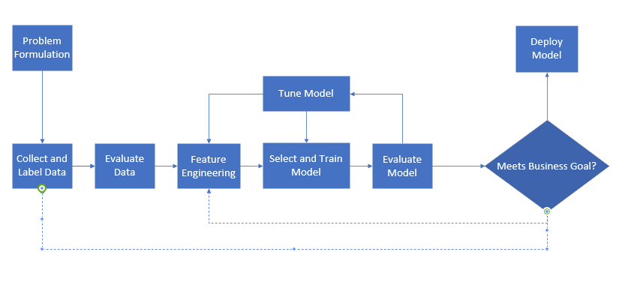
Typical stages in a Machine Learning Lifecycle

Slide 9

Stage 1. Problem Formulation: Before the start of any ML project, it is critical to analyze the problem and the business needs for it. This involves understanding the business context and identifying the challenges business is currently facing and defining business objectives. Some questions that need to be answered at this stage are:
How can an ML solution address the current challenges?
Can problem be translated into a proper ML/AI problem? Does problem fit into any of the ML trainings categories: supervised, unsupervised, etc.? What are costs/benefits of implementing a machine learning solution?
How about availability, size and type of the data? Where is the data coming from? Does data need cleaning?
Where and how the ML solution is deployed and monitored?
How to measure the success of the ML solution?

Slide 10
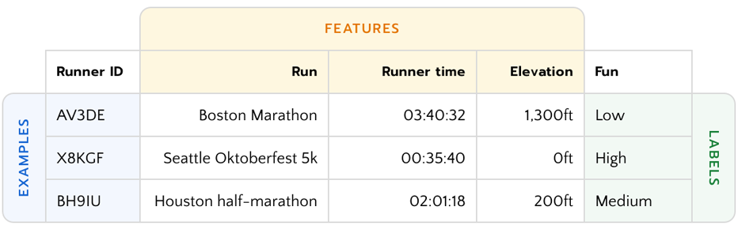
Stage 2. Collect/Load and Label Data Collected: Collect, load and label data, possibly from different sources and in different format. Data must be converted to a uniform format.
Python has an extensive support for reading tabular data of varying types into a Python dataFrame for analysis. A dataFrame is like a table with rows and columns. Columns form the features and rows are individual observations or data points.

Slide 11
Pandas Data Loading: The Read Functions
Pandas provides several functions for reading tabular data in a DataFrame object as listed below. Among them read_csv is one of the most frequently used.
read_csv : Load delimited data from a file, URL, or file-like object; use comma as default delimiter
read_excel : Read tabular data from an Excel XLS or XLSX file( may require to install ‘openpyxl'. Use pip or conda to install openpyxl
read_html : Read all tables found in the given HTML document
read_json : Read data from a JSON (JavaScript Object Notation) string representation
read_pickle : Read an arbitrary object stored in Python pickle format
read_sas : Read a SAS dataset stored in one of the SAS system’s custom storage formats
read_sql : Read the results of a SQL query (using SQLAlchemy) as a pandas DataFrame
read_xml : Read a table of data from an XML file

Slide 12
Stage 3. Data Evaluation/Analysis: This step involves initial data exploration that includes statistical analysis of features. We examine data types, number of missing data, perform descriptive statistics and visualize data.
The goal of data exploration is to gain insights into the data before cleaning it. The initial exploration will also inspire subsequent feature engineering and model building. Exploration includes visual and statistical inspection of the data. Among exploration tasks are:
Identifying column names and their data types (number, text, object, etc.), and whether the column/feature is continuous or categorical. If categorical, is it ordinal ( small, medium, large) or nonordinal ( Ford, GM, Chevy). If continuous, is it discrete or not?
Reviewing key statistical description such as the min, max, std, median, etc. for continuous features to gain additional insight into each feature.

Slide 13
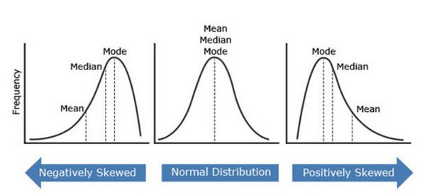
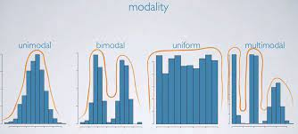
Plotting histogram for a visual representation of the distribution of data: location, spread and skewness of the data.
The distribution features can be symmetric or skewed left or right. A distribution can be unimodal, bimodal or multimodal.
Use correlation matrix to examine the strength of relationship among features

Slide 14
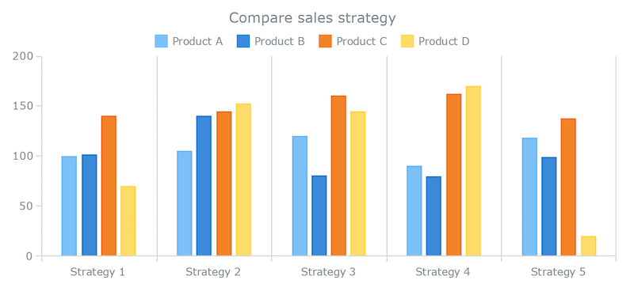
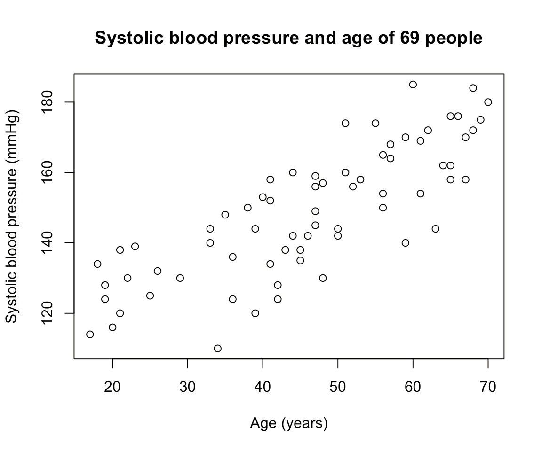
Use bar charts to make numerical comparisons among the categorical features.
Use scatter plots for multivariable analysis and visualization.

Slide 15
Stage 4. Feature Engineering: Feature engineering deals with feature extraction , data clearing and feature selection .
Feature extraction is the process of building information from raw data by reformatting, combining and transforming primary features into new ones.
Data is examined for invalid values, missing values, wrong formats, misspelling, and duplicates
May perform operations to rescale data, encode categories, remove or reassign outliers
Additional operations on data may include bucketing (https://developers.google.com/machine-learning/data-prep/transform/bucketing), transformation, normalization (https://www.analyticsvidhya.com/blog/2020/04/feature-scaling-machine-learning-normalization-standardization/) or dimensionality reduction of data.

Slide 16
Data cleaning can be considered as a step in the feature engineering and extraction.
Data cleaning is done to improve the quality of data and prepare it for further analysis and model training.
This ensures strings are all consistent ( values such as: Female, F, f, female must have a consistent naming)
Variables must use a consistent scale ( as an example: house value feature versus number of bedrooms in the house)
Some data features might capture more than one variable in a single value.
A single variable like “safe neighborhood and great view” should be split into two separate variables/features.

Slide 17
Dataset might be missing values for some variables, or might have outliers
Update missing values with data that’s meaningful and relevant to the problem, drop or impute (replace) the missing values.
Impute if missing values are randomly spread and don’t represent a larger portion of the respective row or a column.
Drop rows and columns if they contain many missing values.
Univariate outliers are abnormal values in one feature. A boxplot is commonly used to find univariate outliers.
Multivariate outliers are abnormal values in a combination of two or more features. A scatter plot can be used to identify multivariate outliers

Slide 18
Ways to deal with an outlier
Delete outliers
Reduce variation by transforming them, like taking the natural log of the values
Impute them with new values such as the mean of the data

Slide 19
Feature selection comes after extracting and cleaning the data.
This step involves selecting the most appropriate features for training models. There are three main feature selection methods
Filter method: use statistical methods to measure the relevance of the features by their correlation with the target variable. A fast and cost-effective approach.
Pearson’s correlation coefficient measures the statistical relationship association between two continuous variables
Analysis or variance ( ANOVA) used to analyze the differences among group means in a sample. Used when feature is categorical, and your target is numerical
Chi-square is a single number that tell you how much difference is between your observed counts and the counts you would expect if there were no relationships in the population. The chi-square test is used when both your feature and target variables are all categorical variables

Slide 20
Wrapper method: measure how useful a subset of the features would be. This is done by training the model on the subset features and measuring the success of the model. Often finds the best subset but risks overfitting and is costly.
Forward selection starts with no features and adds them until the best model is found.
Backward substitution starts with all features and drops them one at a time and then selects the best model.
Embedded methods: are algorithm specific and may use a combination of both filters and wrappers
LASSO and RIDGE regression are built in penalization functions to reduce overfitting y = ax1 + bx2 + cx3+ d

Slide 21
5. Select and Train Model: In this stage an algorithm is selected, and a model trained on the features most relevant to the target variable is produced.
Split the data into training data, (validation data if needed) and test data . Use 80% for training, 10% for validation and 10% for test.
Data in specific order can lead to biases in the model. Randomize data ( shuffle) prior to splitting.
With smaller data set use stratified sampling. It ensures that the training and test sets have approximately the same percentage samples of each target class as the complete set
Training data includes features and labels and is feed into the algorithm to train the model.

Slide 22
Use the model to make predictions over the validation dataset. Tweak, tune and make changes to the hyperparameters.
When ready, run model on test data to make predictions. The performance obtained on the test data is what we can expect to see in production.
A small dataset can use k-fold cross validation to utilize as much data as possible but still having good metrics in order to choose which model is better.
K-fold cross validation randomly partitions data into k different segments. For each segment we use the data outside of it for training then do validation on that segment.

Slide 23
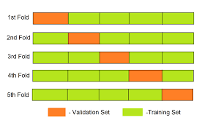
Cross validation can be used in
Hyperparameter tuning
Model selection
Feature selection
Ref: https://www.youtube.com/watch?v=6dbrR-WymjI
Some of the cross-validation techniques are : 1. K- fold cross-validation 2. Stratified k-fold cross-validation.

Slide 24
Commonly used Machine Learning Algorithms for model training are
Linear and logistic regression
Decision Tree
Random Forest
Support Vector Machine (SVM)
Naive Bayes
K - Nearest Neighbor (KNN)
Gradient Boosting algorithm: XGBoost
K-Means
Dimensionality Reduction Algorithms

Slide 25
Stage 6. Test and Evaluate Model: A trained mode is evaluated for accuracy on the validations data. Hyperparameter tuning is performed, then model is retrained with the new set of hyperparameters for improved accuracy score.
Model hyperparameters are those parameters that are not learned from the training and must be entered by the user.
Examples: Kernel and slack in SVM algorithm, or the value of K in KNN algorithm, or the depth of the tree in Decision Tree algorithm.
Model tuning involves, improving model performance by iterating the parameter values during model building. After fine-tuning, the model needs to be re-build.
Model parameters are the properties of the training data that are learned during training by the algorithm from the data.
After selecting optimal hyperparameters, run the model on test data and evaluate the model performance using the correct metric based on the business use case.

Slide 26
Model evaluation metrics trade-off:
Machine learning mostly deals with two tradeoffs, 1. Bias-variance tradeoff and 2. Precision-Recall tradeoff
Overfitting: the model is trying to capture all the patterns in the training data. Fails to perform in the test data.
Underfitting: the model is not learning properly in the training data and also not performing well in test data.
The feature engineering, selection and training, evaluation and hyperparameter tuning are iterative processes.

Slide 27
Stage 7. Delpy Models: Deploy model in a production line as a webpage or an API.
Some tools for deployment are:
Heroku
Amazon Web Services, Google AutoML, Microsoft Azure
Stage 8. Evaluate/Monitor Results: Continue to perform evaluation to see how the model performs on any new data it encounters. Test and probe the model for various trends.
Evaluate new data —It’s important to perform evaluation to see how the model performs on any new data it encounters.
Continue understanding model —Continuously test and probe model for various trends that could cause problems if they were to be discovered by clients instead.

Slide 28



Data Loading in Python ( optional)
A comma-separated (CSV) text file:
data = pd.read_csv(“c:\\tips.csv")
A tabulated data file may not have a header row at the top. Setting header to “None” will use indices for column header starting with index zero
data=pd.read_csv(“c:\\tips.csv", header=None)
You can use pandas default column names, if they exist. Or specify your own names
data=pd.read_csv("C:\\tips.csv", names=['a','b','c','d','e','f','g'])

Slide 29
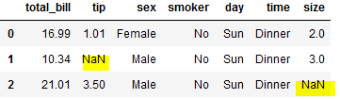
Data Loading
Handling missing values is an important and frequently occurring part of the file parsing process. Missing data is usually either not present (empty string) or marked by some sentinel (placeholder) value. By default, pandas uses a set of commonly occurring sentinels, such as NA or NULL:
The na_values option can take either a list or a set of strings to consider as missing values:
data=pd.read_csv("C:\\tips2.csv", na_values=['NULL'])
If you want to only read a small number of rows (avoiding reading the entire file), specify that with nrows:
data=pd.read_csv("C:\\tips2.csv", nrows=5)

Slide 30

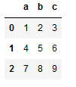
Data Loading
JSON stands for JavaScript Object Notation. It stores data as key-value pair. The basic types for values are objects (dicts), arrays (lists), strings, numbers, booleans, and nulls.
The pandas.read_json can automatically convert an array of JSON objects to a DataFrame. By default, pandas.read_json assume that each object in the JSON array is a row in the table:
Consider an array of json objects stored in the file temp.txt
temp.json
Import json
data2 = pd.read_json("c:\\temp.json")

Slide 31
Data Loading
To export data from pandas to JSON, we can use the to_json methods on DataFrame. For example:
print(data2.to_json(orient='records’))
will print
[{"a":1,"b":2,"c":3},{"a":4,"b":5,"c":6},{"a":7,"b":8,"c":9}]

Slide 32
Data Loading
Python has many libraries for reading and writing data in the ubiquitous HTML and XML formats. Examples include lxml, Beautiful Soup, and html5lib. All must be installed first.
Pandas has a built-in function, read_html, which uses libraries like lxml and Beautiful Soup to automatically parse tables out of HTML files as DataFrame objects.
Pandas is capable of reading XML files as well. It uses lxml.objectify, to parse the file and get a reference to the root node of the XML file.

Slide 33
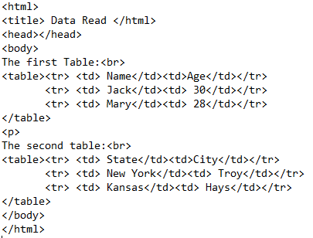
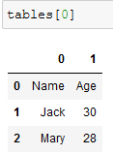
Data Loading
Consider the HTML file below on the left and the read_html parser command on the right that produces the dataframe. Read_html function read tables of HTML files as Pandas DataFrames.
Pandas needs help from another library, called lxml to parse HTML and XML files.
Note that other python libraries such as BeautifulSoup4 and html5lib packages could be used for web scraping. Read more about parsing tools: https://analyticsindiamag.com/top-7-python-web-scraping-tools-for-data-scientists/
A good site read more about html tables: https://stackabuse.com/reading-and-writing-html-tables-with-pandas/
temp1.html
#need to install one of the libraries below
#in this example lxml lib. is installed
pip install lxml
# pip install BeautifulSoup4
# pip install html5lib
tables = pd.read_html("c:\\temp1.html")

Slide 34
Data Loading: Binary File Format
One simple way to store data (also known as serialization) efficiently in binary format is using Python’s built-in pickle serialization.
Objects in Pandas have a to_pickle method that writes the data to a disk in pickle format:
data.to_pickle(‘temp2.pickel’) or .p
This file can later be read into a dataframe:
data2 =pd.read_pickle(‘temp2.pickel’)
Pickle format is only recommended as a short-term storage format. The problem is that it is hard to guarantee that the format will be stable over time
pandas has a built-in support for several other open-source binary data formats, such as HDF5, ORC, and Parquet

Slide 35
Data Loading: Reading Microsoft Excel File
Pandas also supports reading tabular data stored in Excel 2003 (and higher) files using either the ExcelFile class or pandas.read_excel function.
xlsData = pd.ExcelFile(‘example.xlsx’)
Data stored in a sheet can then be read into DataFrame
pd.read_excel(xlsData, 'Sheet1’)
To write pandas data to Excel format, use to_excel function with file path name to_excel
frame.to_excel('ex2.xlsx')

Slide 36
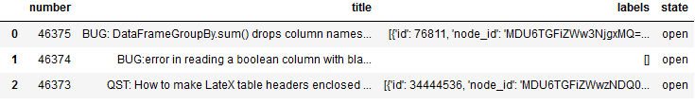
Data Loading: Interacting with Web APIs
Many websites have public APIs providing data feeds via JSON or some other format. There are a number of ways to access these APIs from Python; one method is the requests package.
To find the last 30 GitHub issues for pandas on GitHub, we can make a GET HTTP request using the add-on requests library:
import requests # must import request package
url = 'https://api.github.com/repos/pandas-dev/pandas/issues' # data feed website
resp = requests.get(url) # use of the get method
data = resp.json() # data holds an array of json objects
issues = pd.DataFrame(data, columns=['number', 'title’, 'labels', 'state’]) #turn data into a dataframe

Slide 37
Data Loading: Interacting with Databases
In a business setting, most data may not be stored in text or Excel files. SQL-based relational databases (such as SQL Server, PostgreSQL, and MySQL) are in wide use, and many alternative databases have become quite popular.
Pandas has some functions to simplify loading the results of a SQL query into a DataFrame.
We can create a SQLite database using Python’s built-in sqlite3 driver. Steps for this process is shown in the next side.

Slide 38
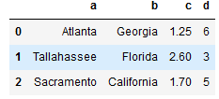
Data Loading: Interacting with Databases
import sqlite3
query = """
.....: CREATE TABLE test
.....: (a VARCHAR(20), b VARCHAR(20),
.....: c REAL, d INTEGER
.....: );""“ # a query to build table test
con = sqlite3.connect('c:\\mydata.sqlite’) # connection string to the database engine
con.execute(query) # run query to build the table test
con.commit()
data = [('Atlanta', 'Georgia', 1.25, 6),
.....: ('Tallahassee', 'Florida', 2.6, 3),
.....: ('Sacramento', 'California', 1.7, 5)] # create an array of records
stmt = "INSERT INTO test VALUES(?, ?, ?, ?)“ # build a SQL insert statement
con.executemany(stmt, data) # execute the insert statement
con.commit()
cursor = con.execute('select * from test’) # query the database just constructed/populated
rows = cursor.fetchall() # an array of json records
df=pd.DataFrame(rows, columns=[x[0] for x in cursor.description]) # convert to dataframe
Here the cursor.description is needed. X[0]’s hold the dataframe header names.

Slide 39
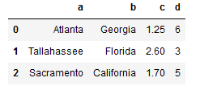
Data Loading: Interacting with Databases
The SQLALchemy is a popular Python SQL toolkit that abstracts away many of the common differences between SQL databases and simplifies database connectivity
pip install sqlalchemy # required installation
import sqlalchemy as sqla
db = sqla.create_engine('sqlite:///c:\\mydata.sqlite’)
pd.read_sql('select * from test', db) # the function read_sql abstracts aways many details

Slide 40
END

